Slide 1

Data structures using C
Module 5 - Lecture II
Searching & Sorting
Prepared By
Ms. Smriti Sehgal

Slide 2
Syllabus
Insertion Sort, Bubble sort, Selection sort, Quick sort, Merge sort, Heap sort, Partition exchange sort, Shell sort, Sorting on different keys, External sorting. Linear search, Binary search, Hashing: Hash Functions, Collision Resolution Techniques.

Slide 3
In this session
We will talk about
Quick sort
Merge sort
Heap sort

Slide 4
Quick Sort
Efficient sorting algorithm
Example of Divide and Conquer algorithm
Two phases
Partition phase
Divides the work into half
Sort phase
Conquers the halves!

Slide 5
Quicksort
Partition
Choose a pivot
Find the position for the pivot so that
all elements to the left are less / equal
all elements to the right are equal / greater
< =pivot
pivot
=> pivot

Slide 6
Quicksort
Conquer
Apply the same algorithm to each half
< pivot
> pivot
<= p’
p’
=> p’
pivot
< =p”
p”
=> p”

Slide 7
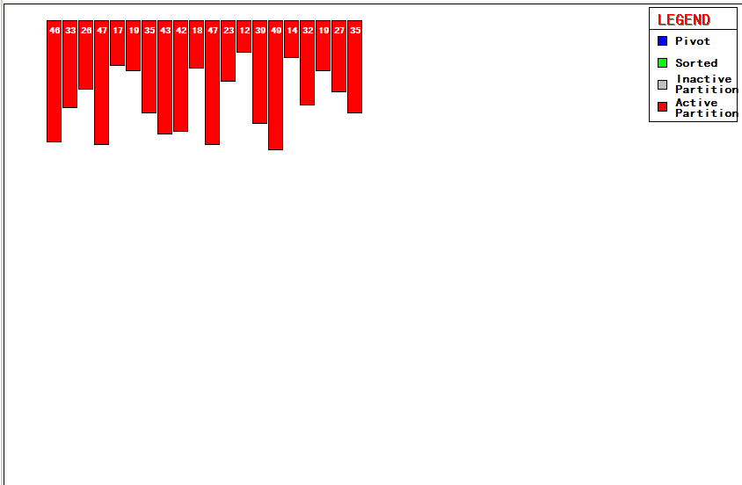
46, 33, 26, 47, 17, 19, 35, 43, 42, 18, 47, 23, 12, 39, 49, 14, 32, 19, 27, 35

Slide 8
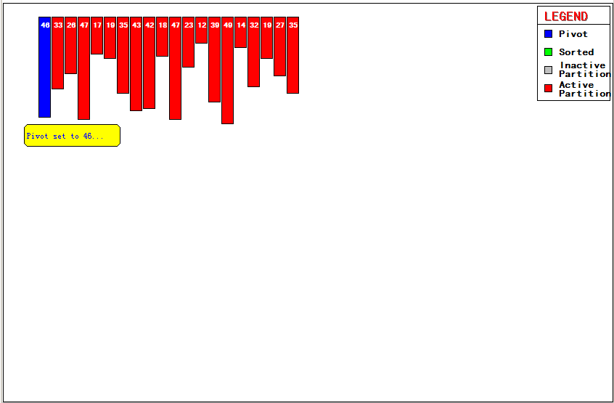
46, 33, 26, 47, 17, 19, 35, 43, 42, 18, 47, 23, 12, 39, 49, 14, 32, 19, 27, 35

Slide 9
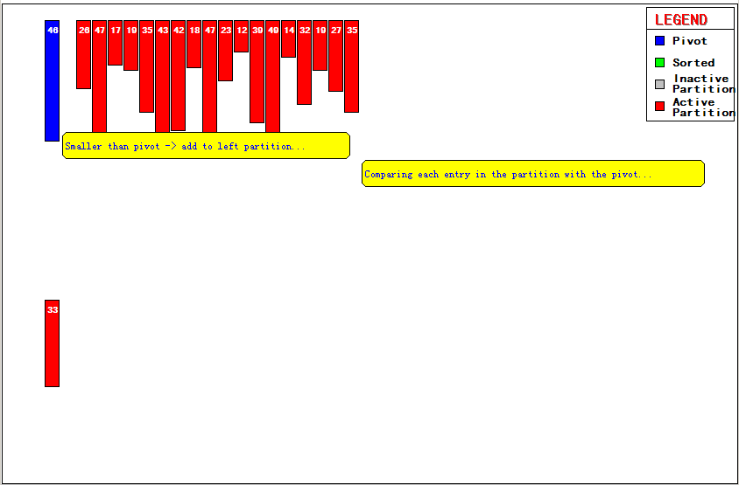
46, 33, 26, 47, 17, 19, 35, 43, 42, 18, 47, 23, 12, 39, 49, 14, 32, 19, 27, 35

Slide 10
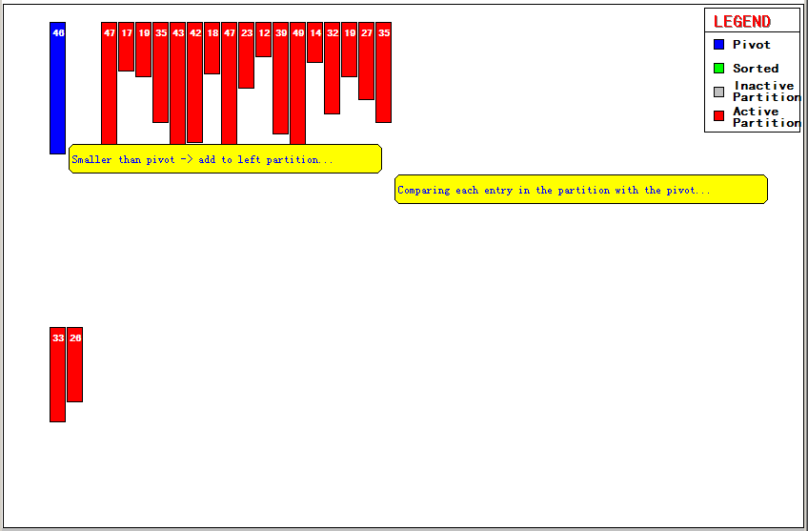
46, 33, 26, 47, 17, 19, 35, 43, 42, 18, 47, 23, 12, 39, 49, 14, 32, 19, 27, 35

Slide 11
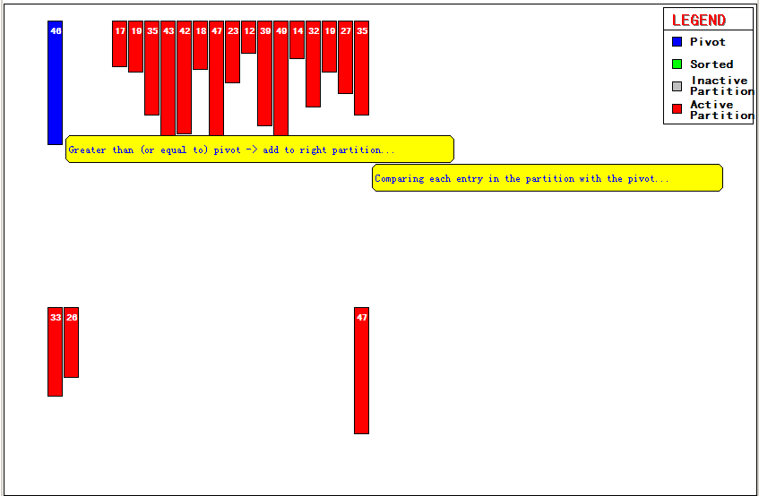

Slide 12
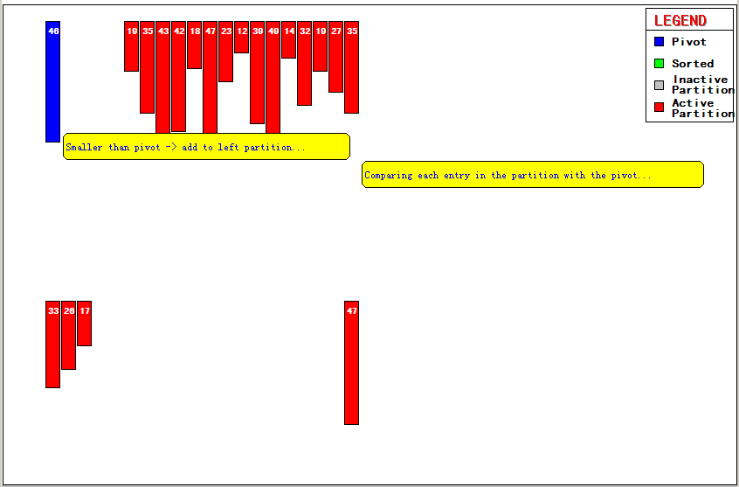

Slide 13
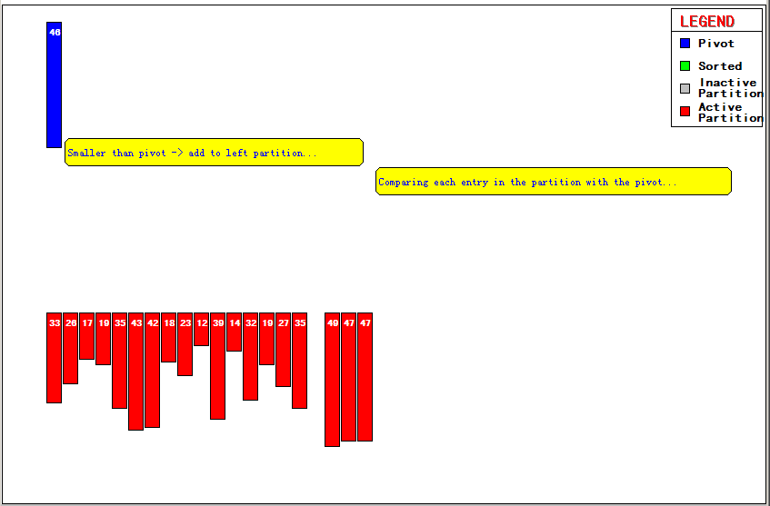

Slide 14
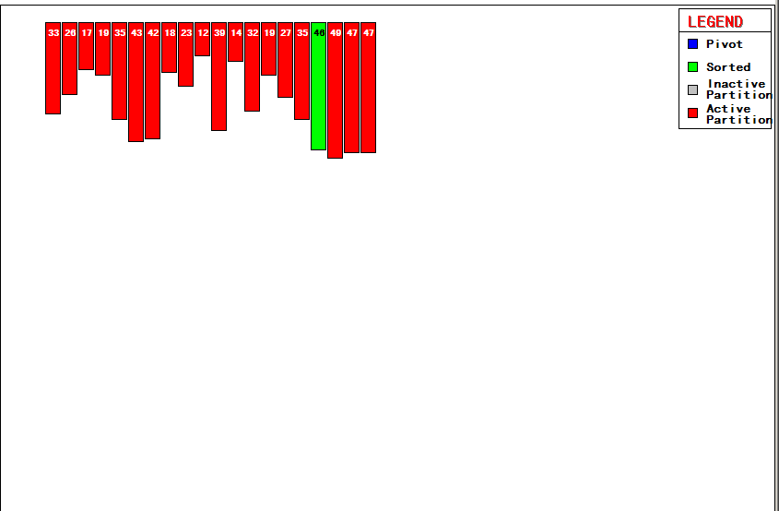

Slide 15
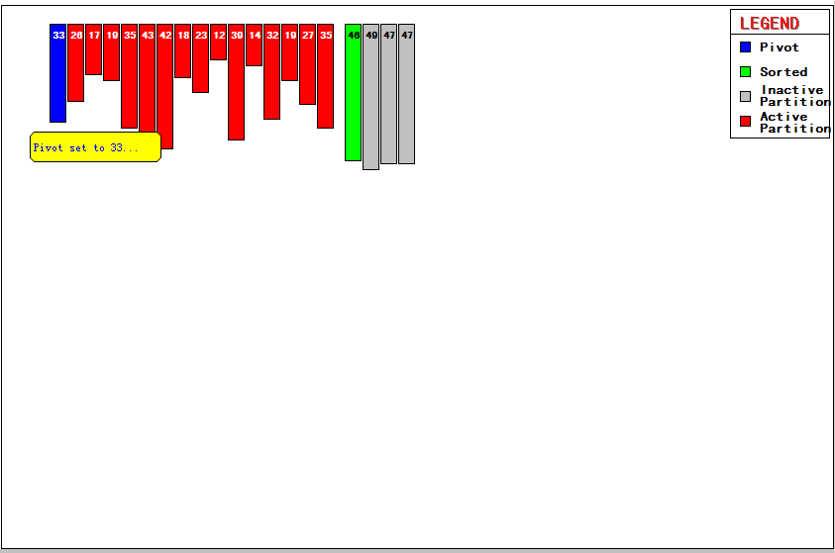

Slide 16
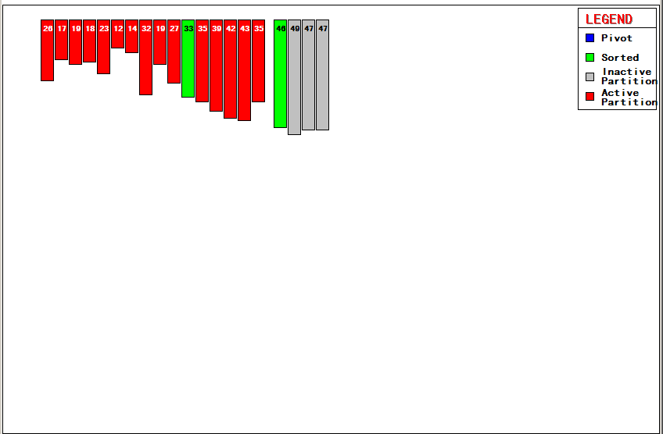

Slide 17
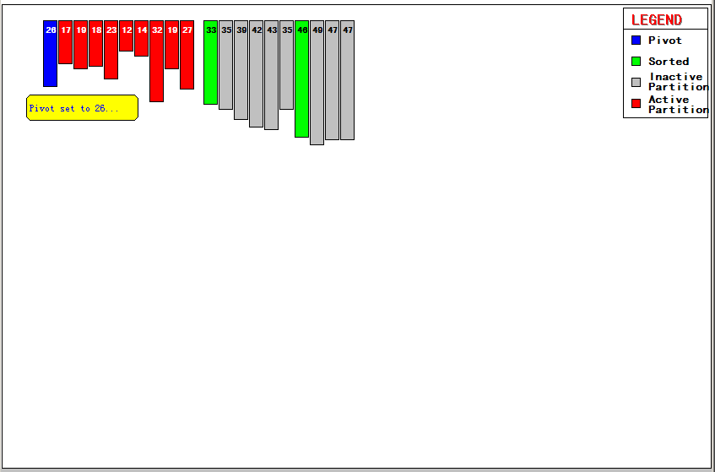

Slide 18
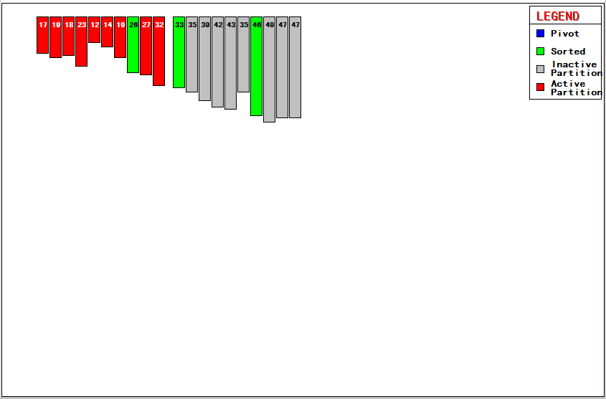

Slide 19
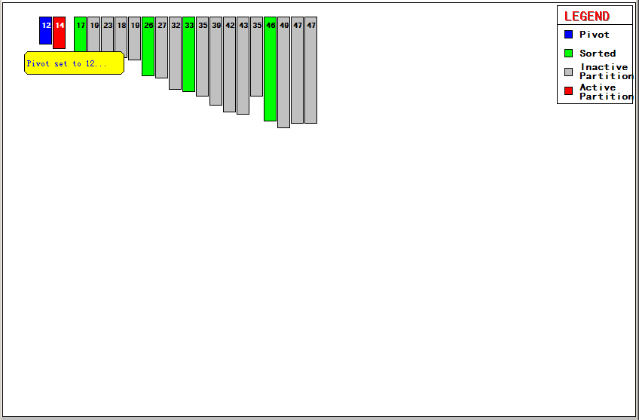

Slide 20
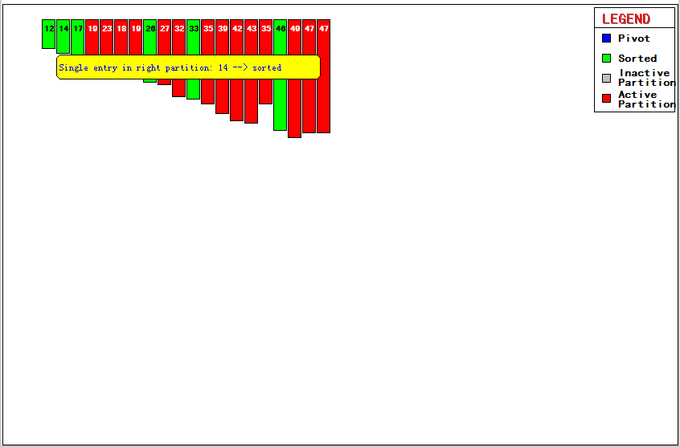

Slide 21


Slide 22
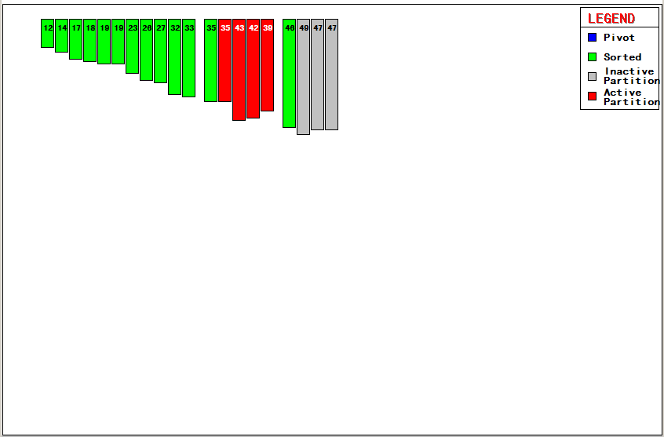

Slide 23
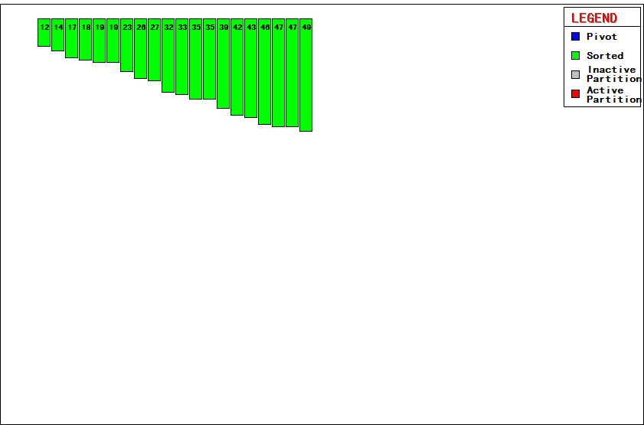

Slide 24
Quicksort
Implementation
quicksort( void *a, int low, int high )
{
int pivot;
/* Termination condition! */
if ( high > low )
{
pivot = partition( a, low, high );
quicksort( a, low, pivot-1 );
quicksort( a, pivot+1, high );
}
}
Divide
Conquer

Slide 25
Quicksort - Partition
int partition( int *a, int low, int high ) {
int left, right;
int pivot_item;
pivot_item = a[low];
pivot = left = low;
right = high;
while ( left < right ) {
/* Move left while item < pivot */
while( a[left] <= pivot_item ) left++;
/* Move right while item > pivot */
while( a[right] > pivot_item ) right--;
if ( left < right ) {
SWAP(a,left,right); left++; right--;
}
}
/* right is final position for the pivot */
a[low] = a[right];
a[right] = pivot_item;
return right;
}

Slide 26
Quicksort - Analysis
Partition
Check every item once O(n)
Conquer
Divide data in half O(log₂n)
Total
Product O(n log n)
Same as Heapsort
quicksort is generally faster
Fewer comparisons

Slide 27
Quicksort vs Heap Sort
Quicksort
Generally faster
Sometimes O(n²)
Better pivot selection reduces probability
Use when you want average good performance
Commercial applications, Information systems
Heap Sort
Generally slower
Guaranteed O(n log n)

Slide 28
Merge Sort - Definition
Definition: A sort algorithm that splits the items to be sorted into two groups, recursively sorts each group, and merge them into a final sorted sequence. Run time is O (n log n).

Slide 29
Merge Sort – Divide-and-Conquer
Divide-and-conquer is a general algorithm design paradigm:
Divide: divide the input data S in two disjoint subsets S1 and S2
Conquer: solve the sub-problems associated with S1 and S2 recursively
Combine: combine the solutions for S1 and S2 into a solution for S
The base case for the recursion are sub-problems of size 0 or 1

Slide 30
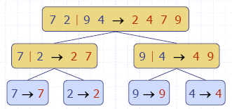
Merge Sort Tree
An execution of merge-sort is depicted by a binary tree
each node represents a recursive call of merge-sort and stores
unsorted sequence before the execution
sorted sequence at the end of the execution
the root is the initial call
the leaves are calls on subsequences of size 0 or 1

Slide 31
Merge Sort - example
Partition
7 2 9 4 | 3 8 6 1

Slide 32
Merge Sort - example
Recursive call, partition
7 2 9 4 | 3 8 6 1
7 2 | 9 4

Slide 33
Merge Sort - example
Recursive call, partition
7 2 9 4 | 3 8 6 1
7 2 | 9 4
7 | 2

Slide 34
Merge Sort - example
Recursive call, base case
7 2 9 4 | 3 8 6 1
7 2 | 9 4
7 | 2
7→7

Slide 35
Merge Sort - example
Recursive call, base case
7 2 9 4 | 3 8 6 1
7 2 | 9 4
7 | 2
7→7
2→2

Slide 36
Merge Sort - example
Merge
7 2 9 4 | 3 8 6 1
7 2 | 9 4
7|2 → 2 7
7→7
2→2

Slide 37
Merge Sort - example
Recursive call, base case, …, base case, merge
7 2 9 4 | 3 8 6 1
7 2 | 9 4
7|2 → 2 7
9|4 → 4 9
7→7
2→2
9→9
4→4

Slide 38
Merge Sort - example
Merge
7 2 9 4 | 3 8 6 1
72|94 → 2 4 7 9
7|2 → 2 7
9|4 → 4 9
7→7
2→2
9→9
4→4

Slide 39
Merge Sort - example
Recursive call, …, merge, merge
7 2 9 4 | 3 8 6 1
72|94 → 2 4 7 9
3 8 6 1→1 3 8 6
7|2 → 2 7
9|4 → 4 9
3 8 → 3 8
6 1 → 1 6
7→7
2→2
9→9
4→4
3→3
8→8
6→6
1→1

Slide 40
Merge Sort - example
Merge
7294|3861 → 12346789
72|94 → 2 4 7 9
3 8 6 1→1 3 8 6
7|2 → 2 7
9|4 → 4 9
3 8 → 3 8
6 1 → 1 6
7→7
2→2
9→9
4→4
3→3
8→8
6→6
1→1

Slide 41
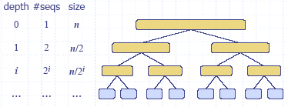
Merge Sort - analysis
The height h of the merge-sort tree is log n + 1 = O(log n)
at each recursive call we divide in half the sequence
The overall amount or work done at the nodes of depth i is O(n)
we partition and merge 2^{i} sequences of size n/2^{i}
we make 2^{i+1} recursive calls
Thus, the total running time of merge-sort is O(n log n)

Slide 42
Merge Sort – sample code
void mergesort(int low, int high)
{
if (low<high)
{
int middle=(low+high)/2;
mergesort(low, middle);
mergesort(middle+1, high);
merge(low, middle, high);
}
}

Slide 43
Merge Sort – sample code (cont.)
void merge(int low, int middle, int high)
{
int i, j, k;
// copy both halves of a to auxiliary array b
for (i=low; i<=high; i++)
b[i]=a[i];
i=low; j=middle+1; k=low;
// copy back next-greatest element at each time
while (i<=middle && j<=high)
if (b[i]<=b[j]) a[k++]=b[i++];
else a[k++]=b[j++];
// copy back remaining elements of first half (if any)
while (i<=middle)
a[k++]=b[i++];
}
Notes:
How to merge two sorted list?
Initially we put two pointers to the beginning of two lists. Then we begin to move the pointers.
The rule is, keep on moving one pointer until the elements it pointed to exceed the element pointed by the other pointer.
Each time we move either pointer, we put the corresponding element in the new merged list.

Slide 44
Heap data structure
Binary tree
Balanced
Left-justified or Complete
(Max) Heap property: no node has a value greater than the value in its parent

Slide 45
Balanced binary trees
Recall:
The depth of a node is its distance from the root
The depth of a tree is the depth of the deepest node
A binary tree of depth n is balanced if all the nodes at depths 0 through n-2 have two children
n-2
n-1
n
Balanced
Balanced
Not balanced

Slide 46
Left-justified binary trees
A balanced binary tree of depth n is left-justified if:
it has 2^{n} nodes at depth n (the tree is “full”), or
it has 2^{k} nodes at depth k, for all k < n, and all the leaves at depth n are as far left as possible
Left-justified
Not left-justified

Slide 47
Building up to heap sort
How to build a heap
How to maintain a heap
How to use a heap to sort data

Slide 48
The heap property
A node has the heap property if the value in the node is as large as or larger than the values in its children
12
12
12
8
3
8
12
8
14
Blue node has heap property
Blue node has heap property
Blue node does not have heap property
All leaf nodes automatically have the heap property
A binary tree is a heap if all nodes in it have the heap property

Slide 49
shiftUp
Given a node that does not have the heap property, you can give it the heap property by exchanging its value with the value of the larger child
12
14
8
14
8
12
Blue node does not have heap property
Blue node has heap property
This is sometimes called shifting up

Slide 50
Constructing a heap I
A tree consisting of a single node is automatically a heap
We construct a heap by adding nodes one at a time:
Add the node just to the right of the rightmost node in the deepest level
If the deepest level is full, start a new level
Examples:
Add a new node here
Add a new node here

Slide 51
Constructing a heap II
Each time we add a node, we may destroy the heap property of its parent node
To fix this, we sift up
But each time we sift up, the value of the topmost node in the sift may increase, and this may destroy the heap property of its parent node
We repeat the sifting up process, moving up in the tree, until either
We reach nodes whose values don’t need to be swapped (because the parent is still larger than both children), or
We reach the root

Slide 52
Constructing a heap III
8
8
10
10
10
8
8
5
1
2
3
10
10
12
8
5
12
5
10
5
12
8
8
4

Slide 53
Other children are not affected
12
12
14
10
5
14
5
12
5
8
14
8
10
8
10
The node containing 8 is not affected because its parent gets larger, not smaller
The node containing 5 is not affected because its parent gets larger, not smaller
The node containing 8 is still not affected because, although its parent got smaller, its parent is still greater than it was originally

Slide 54
A sample heap
Here’s a sample binary tree after it has been heapified
25
22
17
19
22
14
15
18
14
21
3
9
11
Notice that heapified does not mean sorted
Heapifying does not change the shape of the binary tree; this binary tree is balanced and left-justified because it started out that way

Slide 55
Removing the root (animated)
Notice that the largest number is now in the root
Suppose we discard the root:
11
22
17
19
22
14
15
18
14
21
3
9
11
How can we fix the binary tree so it is once again balanced and left-justified?
Solution: remove the rightmost leaf at the deepest level and use it for the new root

Slide 56
The reHeap method I
Our tree is balanced and left-justified, but no longer a heap
However, only the root lacks the heap property
11
22
17
19
22
14
15
18
14
21
3
9
We can shiftDown() the root
After doing this, one and only one of its children may have lost the heap property

Slide 57
The reHeap method II
Now the left child of the root (still the number 11) lacks the heap property
22
11
17
19
22
14
15
18
14
21
3
9
We can siftDown() this node
After doing this, one and only one of its children may have lost the heap property

Slide 58
The reHeap method III
Now the right child of the left child of the root (still the number 11) lacks the heap property:
22
22
17
19
11
14
15
18
14
21
3
9
We can shiftDown() this node
After doing this, one and only one of its children may have lost the heap property —but it doesn’t, because it’s a leaf

Slide 59
The reHeap method IV
Our tree is once again a heap, because every node in it has the heap property
22
22
17
19
21
14
15
18
14
11
3
9
Once again, the largest (or a largest) value is in the root
We can repeat this process until the tree becomes empty
This produces a sequence of values in order largest to smallest

Slide 60
Sorting
What do heaps have to do with sorting an array?
Here’s the neat part:
Because the binary tree is balanced and left justified, it can be represented as an array
All our operations on binary trees can be represented as operations on arrays
To sort:
heapify the array;
while the array isn’t empty {
remove and replace the root;
reheap the new root node; }

Slide 61
Key properties
Determining location of root and “last node” take constant time
Remove n elements, re-heap each time

Slide 62
Analysis
To reheap the root node, we have to follow one path from the root to a leaf node (and we might stop before we reach a leaf)
The binary tree is perfectly balanced
Therefore, this path is O(log n) long
And we only do O(1) operations at each node
Therefore, reheaping takes O(log n) times
Since we reheap inside a while loop that we do n times, the total time for the while loop is n*O(log n), or O(n log n)

Slide 63
Analysis
Construct the heap O(n log n)
Remove and re-heap O(log n)
Do this n times O(n log n)
Total time O(n log n) + O(n log n)

Slide 64


